Slide 1

Pawsitive Pet Academy
A responsive website and Android app
Client: Sarah Smith
Presented by: ST10515364, ST10516576, ST10514684,
ST10515124
Mr Phalanndwa | Work Integrated Learning | 11/03/2026
Notes:
Good morning/afternoon, everyone. We're [names], and today we're presenting Pawsitive Pet Academy, a responsive website and Android app we built for our client, Sarah Smith. We'll take you through how we designed it, how we built it, and what we learned along the way.

Slide 2



Meet the Client
Sarah Smith runs a small local pet care education business
She teaches pet owners through hands-on courses
The problem: no strong digital presence
Customers couldn't easily see courses or prices online
She needed one place to advertise and take enquiries
Obedience Training
Animal Behaviour
Dog Walking
Notes:
Sarah owns a small local business that teaches pet care, covering obedience training, animal behaviour, and dog walking. Like many small businesses, she didn't have a proper digital presence. Potential customers couldn't easily find course details or work out what it would cost. Our job was to fix that by giving her a professional online face.

Slide 3






The Client's Requirements
Responsive website
Android app
Business advertising
Works on any screen size
Built for phone users
Show off the academy
Course information
Inquiry form
Quote Calculator
Clear details and prices
Easy way to get in touch
5% off for 2 courses, 10% off for 3+
Notes:
After speaking with Sarah, we pinned down what she needed. She wanted a website and an Android app that advertise her business and explain her courses. Customers also needed an inquiry form to get in touch. The standout request was a Quote Calculator that gives instant prices and applies a 5% discount for two courses and 10% for three or more.

Slide 4






User-Centred Design
Understand
Wireframe
Review
Refine
Build
What do pet owners need?
Sketch every screen in Figma
Check layouts and flow
Fix problems early
Code from the designs
We designed around the user, not just the client: simple navigation, clear buttons, and mobile in mind.
Notes:
We used User-Centred Design, which means every decision started with the user. Pet owners are busy, so they want to find course info and get a quote quickly. We kept navigation simple, made buttons obvious, and designed for phones as well as desktops. We refined the designs in Figma before writing any code, which saved us time later.

Slide 5
Colour Palette & Brand
Deep Teal
#2B7A78
Soft Teal
#3AAFA9
Warm Orange
#F4A261
Warm Yellow
#E9C46A
Dark Grey
#1A1A1A
White
#FFFFFF
Teals
Calm and trustworthy
Orange and yellow
Friendly and energetic
Dark grey and white
Readable and clean
Notes:
Our palette balances calm and friendly. The teals feel professional and trustworthy, which matters for a training business. The orange and yellow add warmth and energy, and we use them for buttons and highlights. Dark grey and white keep the text readable. We used the same palette on both platforms so the brand feels consistent. The logo is deliberately neutral, so the teal and orange palette on the website and app carries the colour and the logo works on any background.

Slide 6
The Logo Design
Two paw prints, with a dog's face in the main pad
Simple, friendly and instantly recognisable
Neutral grey and white, so it works on any background
Circular badge scales from favicon to banner
Hand-drawn sketch style adds a warm, personal feel
Notes:
Our logo combines two paw prints with a dog's face inside the main pad, so it's clear what the business is about. The sketch-style paw gives it a warm, hand-drawn feel, while the solid paw keeps it modern and clean. We used neutral grey and white so it works on any background, and the circular badge shape stays clear at any size, from a tiny browser tab icon to a large banner.

Slide 7
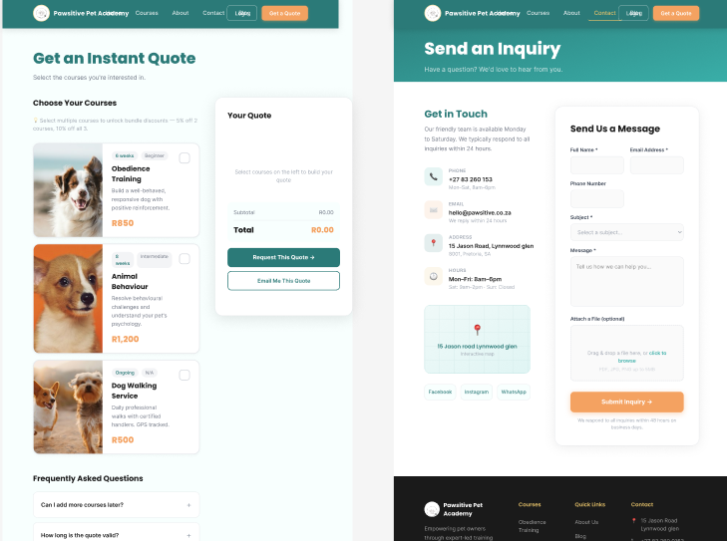
Planning in Figma
24
high-fidelity wireframes
[Insert a grid screenshot of your Figma wireframes here: web frames on one side, mobile frames on the other]
12
website
12
mobile app
Home, courses, quote calculator and inquiry screens. Our blueprint before any code.
Notes:
In Phase 1 we created 24 high-fidelity wireframes in Figma, 12 for the website and 12 for the app. These weren't rough sketches. They showed colours, layout, and content. Having this blueprint meant that when we started coding, we already knew what each screen should look like.

Slide 8
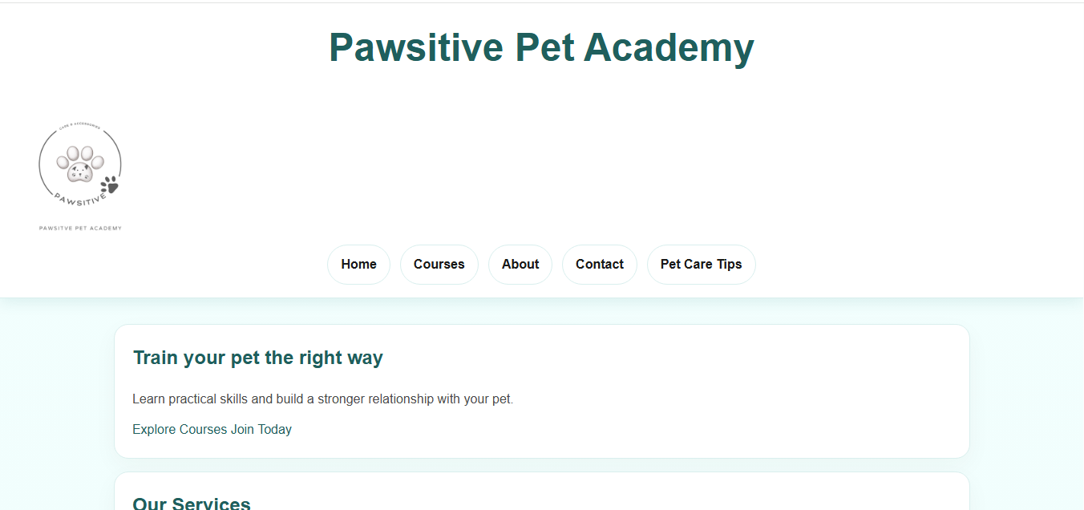
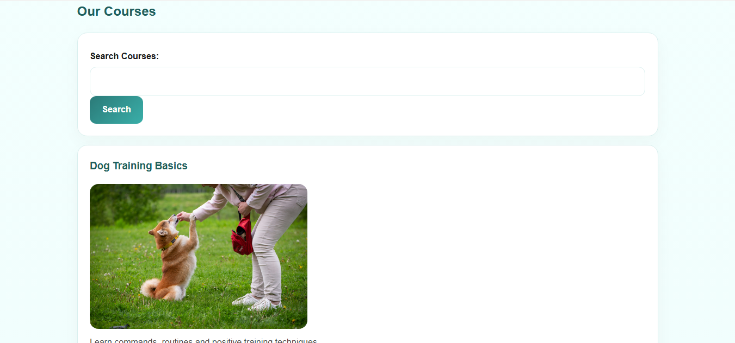
Website Development
Built with HTML, basic CSS and JavaScript
Responsive for phones, tablets and desktops
Pages: Home, Courses, About, Contact, Pet Care Tips, Dashboard, Inquiry Form, Quote Calculator
Extras beyond the brief: student dashboard and pet care tips
Hosted in a public GitHub repository
Notes:
For the website we used HTML for structure, CSS for styling, and JavaScript for interactivity. We kept the tech stack simple but made sure the site is responsive, so it works on any screen size. We built eight pages in total, which is more than the brief asked for: we added a student dashboard and a pet care tips page. The code is in a public GitHub repository, which helped us track changes as a team. [Optional: show a phone-sized view of the site here.]

Slide 9
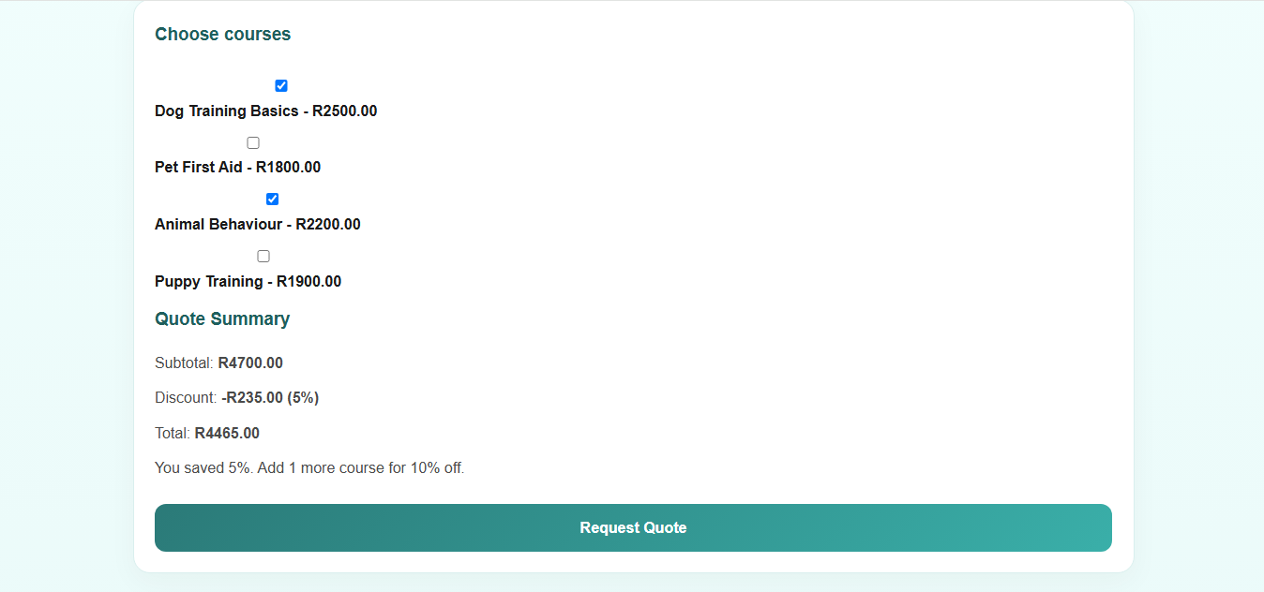
The Quote Calculator
0%
With 1 course: standard price
5%
When you pick 2 courses
10%
When you pick 3 or more
Example: R2500 + R2200 = R4700, less 5% (R235) = R4465
Notes:
This is our most important feature. Here the customer has picked Dog Training Basics at R2500 and Animal Behaviour at R2200, so the subtotal is R4700. Because that's two courses, a 5% discount of R235 is applied, giving a total of R4465. With three or more courses the discount goes up to 10%. The calculator even tells the customer that adding one more course unlocks 10% off, which nudges them towards booking more and saves Sarah from answering the same pricing questions repeatedly.

Slide 10
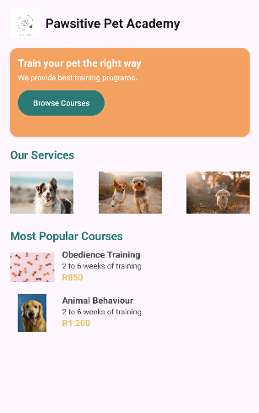
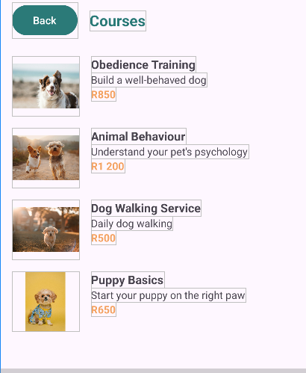
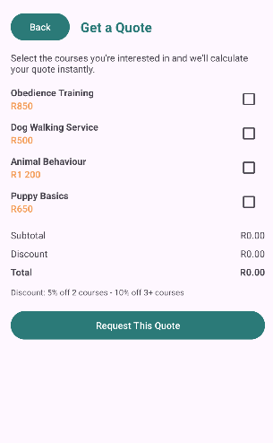
Mobile App Development
Built in Kotlin using Android Studio
Mirrors the website's features and design
Includes the Quote Calculator and inquiry form
Same colours and logo for consistency
Designed for easy use on a phone
[App
screenshot]
[App
screenshot]
[App
screenshot]
Home
Courses
Quote
Notes:
For the Android app we used Kotlin in Android Studio. We followed our mobile wireframes and used the same colours and logo as the website, so customers get the same experience on either platform. The app includes the Quote Calculator and inquiry form, so users can do everything on their phone.

Slide 11
Challenges & Solutions
Form validation with no backend
JavaScript checks for empty or invalid fields and shows clear errors
Getting the discount logic right
Tested every combination of courses
Keeping web and app consistent
Shared palette, logo and wireframes
Team coordination
GitHub for version control
Notes:
We hit a few challenges. The biggest was that our inquiry form has no backend, so we used JavaScript to validate input and show clear error messages. We also tested the discount logic carefully so every combination of courses gave the right price. We relied on our shared palette and wireframes to keep the web and app consistent, and used GitHub to manage teamwork. [Edit this slide to match your real experience.]

Slide 12
Conclusion & Q&A
Delivered a responsive website and an Android app
Met every requirement, including the Quote Calculator
Consistent branding across both platforms
Next steps: a backend so inquiries reach Sarah directly
Thank you!
Notes:
To wrap up, we delivered what Sarah asked for: a responsive website and an Android app that advertise her academy, explain her courses, take inquiries, and calculate quotes with discounts. If we had more time, we'd add a backend so inquiries go straight to Sarah. Thank you for listening, and we're happy to take any questions.

